Slide 1
Types of Database
Prof. Dharmendra Singh Rajput
VIT, Vellore

Slide 2
Document oriented database
Graph database
Hypertext database
Operational database
Embedded database
Distributed database

Slide 3
Document oriented database
A document oriented database is a computer program designed storing, retrieving and managing document oriented or semi structured data information.
No row no columns but collection of JSON documents.
This is also known as schema free database.
It include XML, YAML, and JSON as well as Microsoft Office documents (MS Word, Excel, and so on).

Slide 4
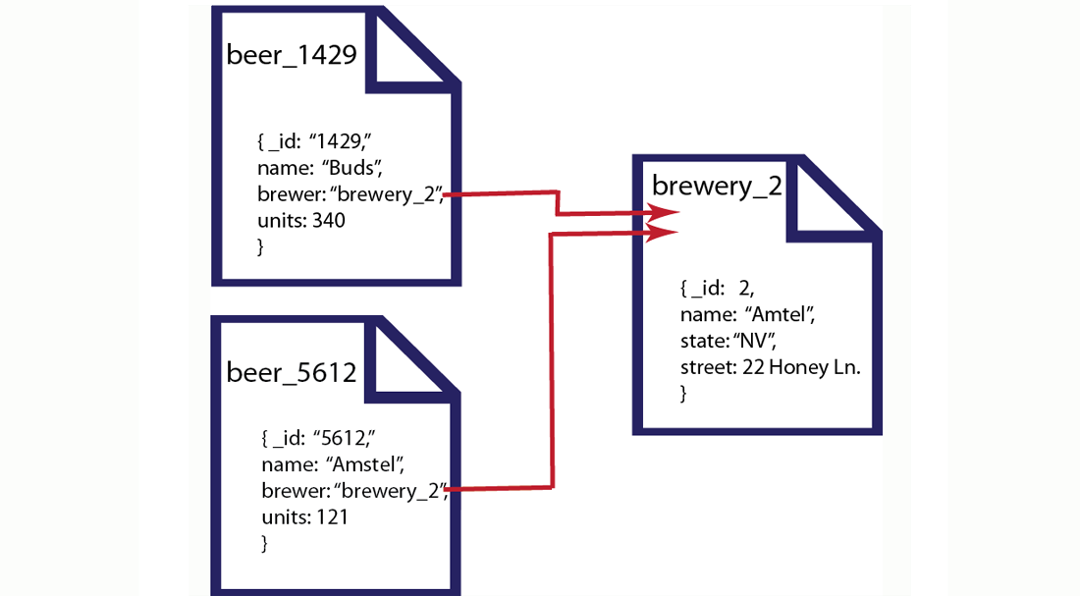
Example

Slide 5
Graph database
Graph database is a kind of SQL database that uses graph structures with nodes, edges and properties to represent and store information.
Graph databases are based on graph theory. Graph databases employ nodes, properties, and edges.
Example Social network, Internet

Slide 6
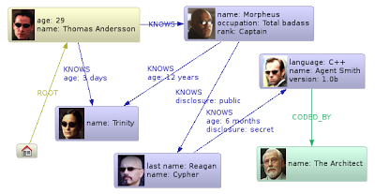
Example

Slide 7

Hypertext database
Hypertext database are particularly useful for organizing large amount of disparate information. For example they are useful for maintaining online encyclopaedias.

Slide 8
Operational Database
These database store detailed data about the operations of an organization.
These types of databases allow you to do more than simply view archived data.
Operational databases allow you to modify that data (add, change or delete data), doing it in real-time.

Slide 9
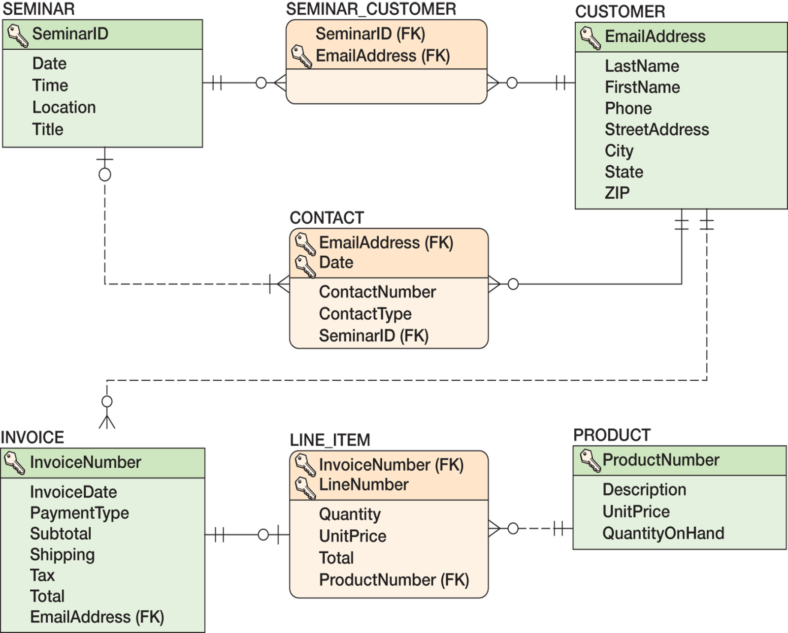
Example

Slide 10
Embedded Database
These database consist of data developed by individual end users.
Example of these are collections of documents, spread sheets, presentations, multimedia and other files.

Slide 11
Distributed database
A distributed database is a database in which storage device are not all attached to common processing unit such as CPU.
It may be stored inn multiple computer located inn the same physical location or may be dispersed over a network of interconnected computer.

Slide 12
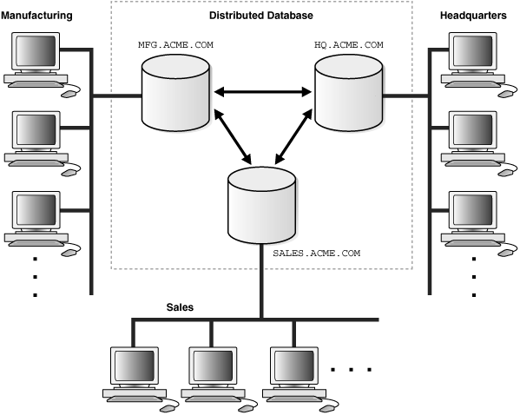
Example

